Slide 1
Capstone Project-I EDA on Hotel Bookings Analysis
Cohort-Zurich
Individual :- Ankur vishwakarma

Slide 2
Points for Discussion
Summary of data
Data Wrangling
City hotels booking vs Resort hotels booking
Busiest Month of Hotels
Optimal length of stay in order to get the best daily rate
Higher number of special request
Relationship between previous cancellations and cancellation
Price in hotels over the year
Relation between Lead time and Cancellation
Monthly cancellations and customer type
Market segment wise bookings
Conclusion

Slide 3
Summary of data
The dataset contains 119390 rows and 32 columns.
This data set contains booking information for a city hotel and a resort hotel and includes information such as when the booking was made, length of stay, the number of adults, children, and/or babies, and the number of available parking spaces, among other things

Slide 4
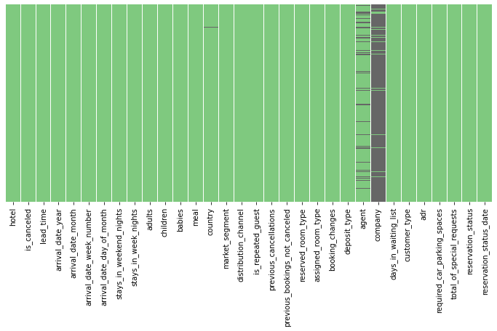
Data Wrangling
Here we can see in respective heat map company column has too many null Values so we will drop it.
'agent' and 'country' columns also have a few null values, so we are replacing Nan values in 'agent' column by median value and in 'country by mode value'.

Slide 5
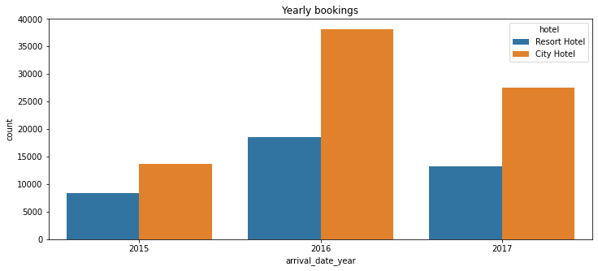
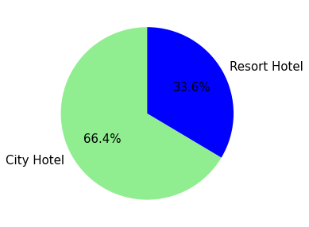
City hotels booking vs Resort hotels booking
City hotels receive more bookings than Resort hotels. Because most of the times people go to Resort Hotels only in vacations or planned engagements. While City hotels are booked for all other purposes, be it work, small events or more.
Also, the accessibility to city hotels is usually more convenient than Resort Hotels.
We conclude 2016 receive most number of bookings

Slide 6
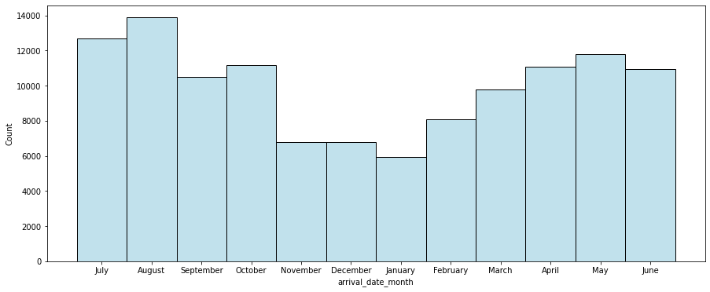
Busiest Month for Hotels
Most of the bookings were made from July to August and peak month is August. Least booking were made at the start and end of the year.

Slide 7
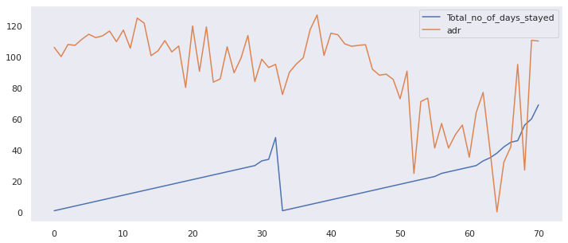
Optimal length of stay in order to get the best daily rate
It is evident that as total number of days stayed goes up, ADR(average daily rate) goes down, so any stay between 50 to around 65 days would be optimal if looked at combined hotel data of both types.

Slide 8
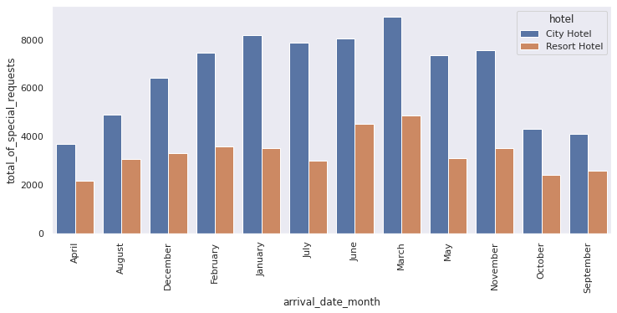
Higher number of special requests
Months with positive deviation plots are the ones with disproportionately higher number of special requests. Here, May, June, July and August are in lead.

Slide 9
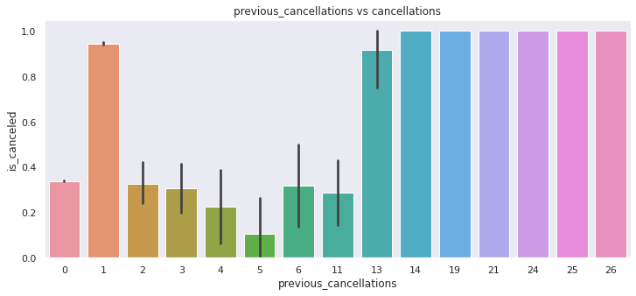
Relationship between previous cancellations and cancellation
Those who have cancelled previously once have high chance of cancellation compared to 0 previous cancellations. For higher values of previous cancellations, numbers are very less and can be ignored.

Slide 10
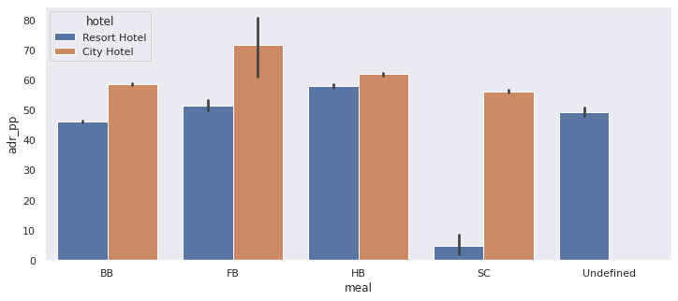
Price in hotels over the year
Prices in the Resort Hotel are much higher during the summer and prices of city hotel varies less and is most expensive during Spring and Autumn and these vary with room type and meal type.

Slide 11
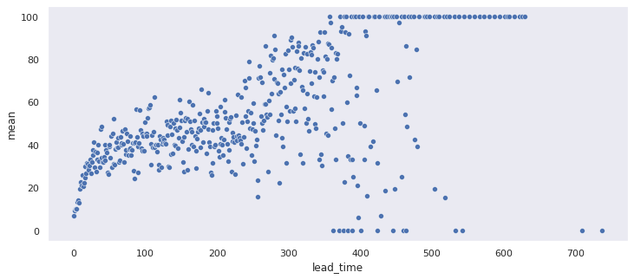
Relation between Lead time and Cancellation
Lead time has a positive correlation with cancellation.

Slide 12
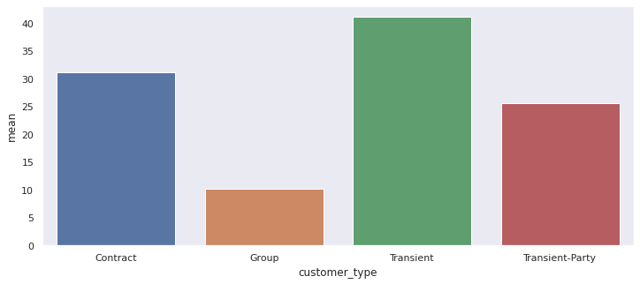
Monthly cancellations and customer type
Transient type has more cancellation

Slide 13
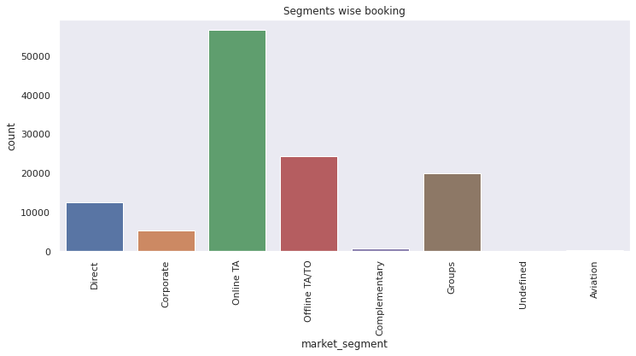
Market segment wise bookings
Online TA segment leads the bookings.

Slide 14
Conclusion
The majority of reservations are for city hotels.
2016 holds the most numbers of booking as per given dataset.
Transient customer types have higher cancellations.
Longer you stay in a resort, lesser ADR will be experienced.
Online TA segment leads the bookings.
Higher lead time has higher chance of cancellation. Also, history of previous cancellations increases chances of cancellation.
The City hotel has more guests during spring and autumn, when the prices are also highest, In July and August there are less visitors, although prices are lower. Thus, customers can get good deal on bookings in July and August in city hotel.
Guest numbers for the Resort hotel go down slightly from June to September, which is also when the prices are highest. Thus, these months should be avoided for bookings.
Broadly, April to August is the peak season of bookings. Both hotels have the fewest guests during the winter.

